Slide 1
Hello and Welcome
STC Professionals
The OPOD Code for Remote check in : 102480
We will begin in a few minutes
Meanwhile if you can please introduce yourselves on the chat..

Slide 2
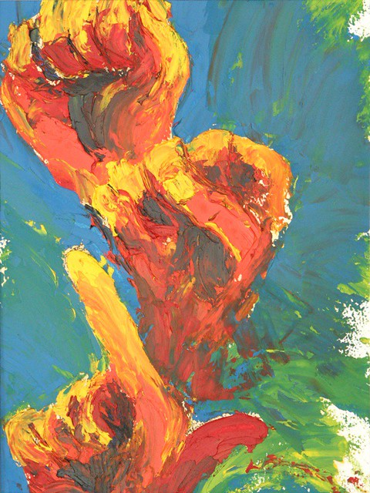
Lets Start Building a Vocabulary Foundation in ASL!
Goal: Is to expose and teach individuals basic ASL vocabulary like: ABC’s and commonly used basic vocabulary
Presented By: Priscilla Garcia

Slide 3
Benefits of Learning ASL
Why is it important to learn ASL:
Promotes better awareness of and sensitivity to the deaf and hard of hearing community… plus..
Improves Spelling ( can be used as a tool to help children remember spelling words and leaves a larger imprint on the brain)
Builds and improves good motor skills
Builds communication skills
Builds a better vocabulary
Introduces you to a new culture and community
Improves your peripheral vision and reaction time
Its all around us!!

Slide 4
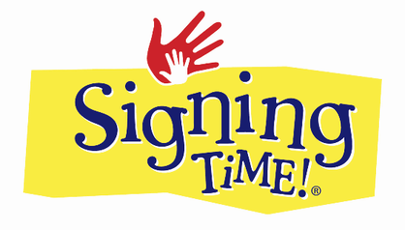
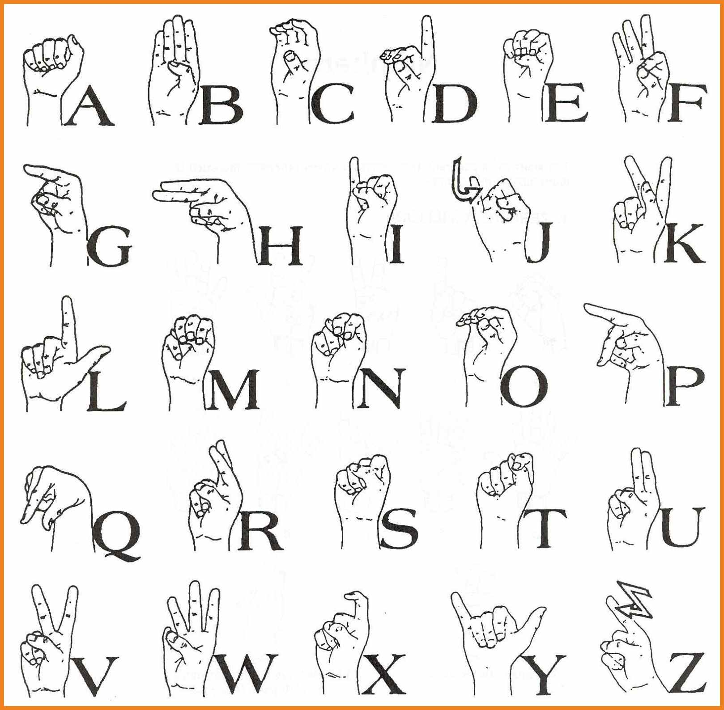
The Alphabet in ASL

Slide 5
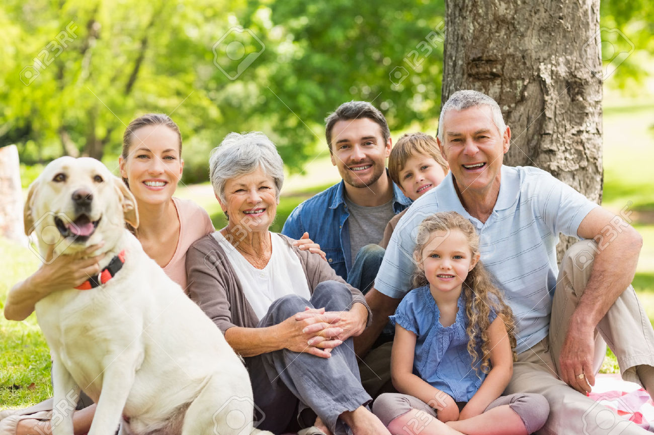
Family Signs
Sister (girl + both hands in l shape)
Brother (boy + both hands in L shape)
Grandmother
Grandfather
Aunt
Uncle
Cousins
Immediate Family:
Family
Mother (Mom) (2 ways) can add the wiggle movement
Father (Dad) (2 ways) can add the wiggle movement
Parents (Mother & Father)
Baby
Daughter / Girl
Son / Boy
Family:

Slide 6
Other signs for Individuals & People
Female (woman)
Male (man)
Children
Person (2) (Individual & with P)
Teacher (teach + person)
Instructor (I teach + person)
Doctor
Fireman
Policeman
Etc…….

Slide 7
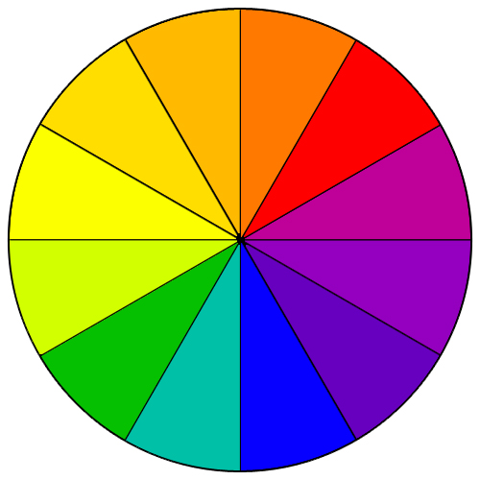
Colors and More Colors

Slide 8
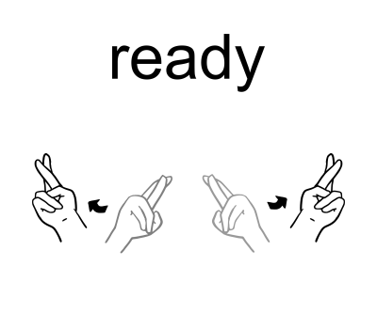
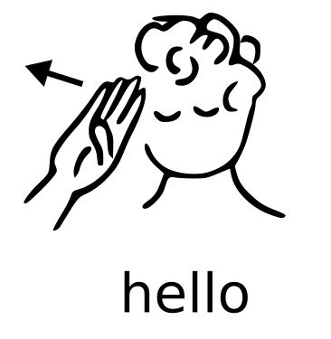
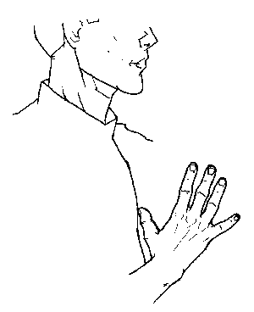
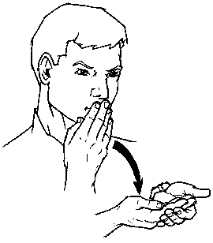
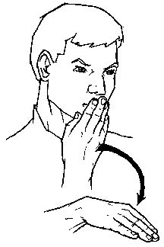
Conversational Words and Phrases
YOU
HOW
“How are You”
“Fine”
“Good”
“Bad”

Slide 9
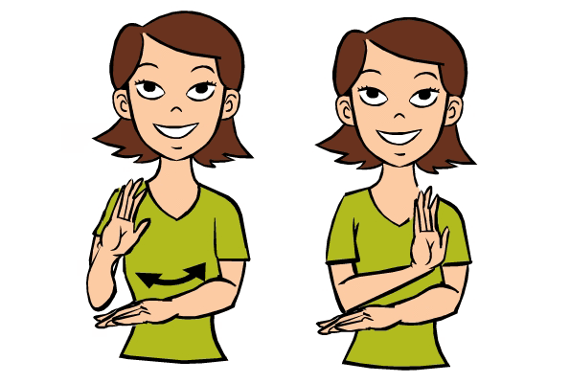
Conversational Words and Phrases (continued)
What’s Up?
(Responses)
“Nothing”
“Busy”

Slide 10
Any Questions or repeats of signs…
Time to Share!!! Background information:
Why were you all interested in this workshop??
What did you expect to learn?
Did this workshop meet Your expectations??
Notes:
In Slide Show mode, select the arrows to visit links.

